Slide 1

Tools of the Trade: GIS
15th Annual AMS Student Conference
10 January 2016 | New Orleans, LA
J. Greg Dobson, GISP

Slide 2
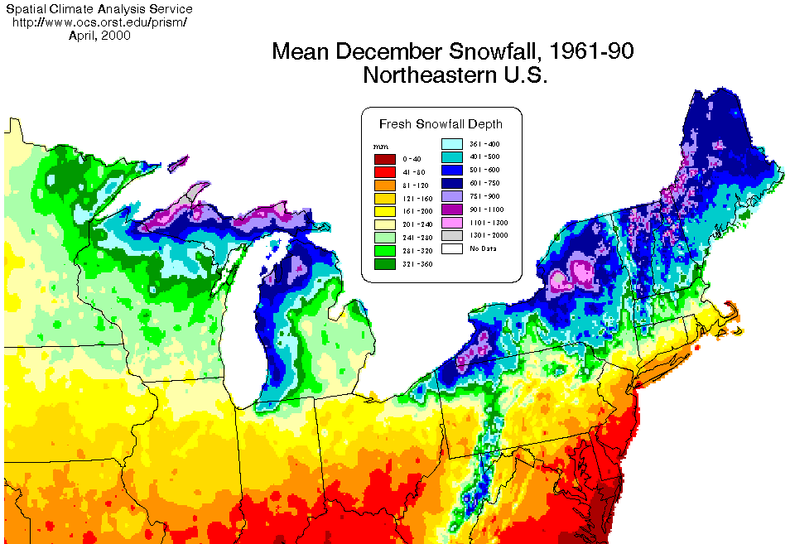
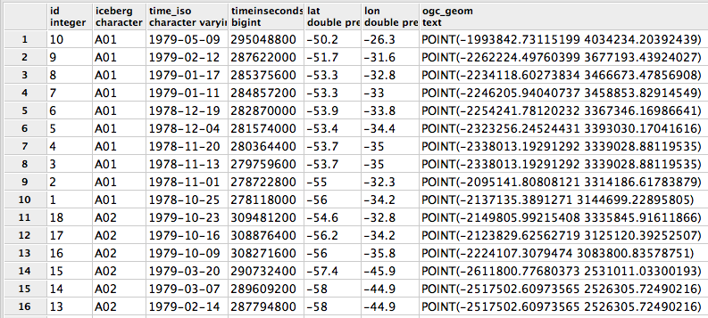
What is a GIS You Ask
Geographic Information System(s)
A set of tools, methods, analyses, and processes for using geographic information
Links tables of information, or “attribute data” with spatial data on a map
Can then ask “spatial questions” about the data
Notes:
Tabular data is not easy to interpret, GIS allows for vizualization

Slide 3
Why Integrate GIS with Weather & Climate
Studying atmospheric sciences (meteorology, climatology, hydrology, etc.) requires knowledge of the “geo” sciences
Weather and climate issues force us to create, interpret, analyze, and disseminate map-based geographic information
Combine atmospheric data with other geographic data and ask complex spatial-oriented questions
Work with BIG Data
Notes:
Note how the atmospheric sector is now fully embracing GIS and it is critical for ATMS students to be learning GIS skills

Slide 4
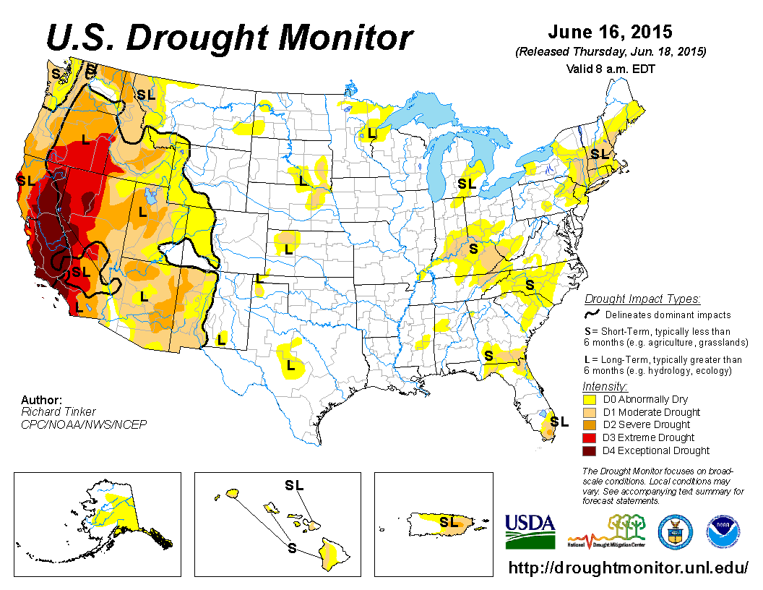
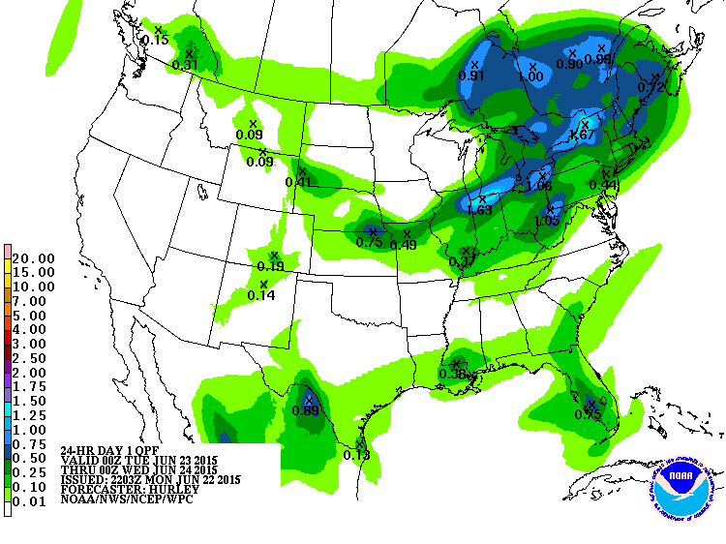
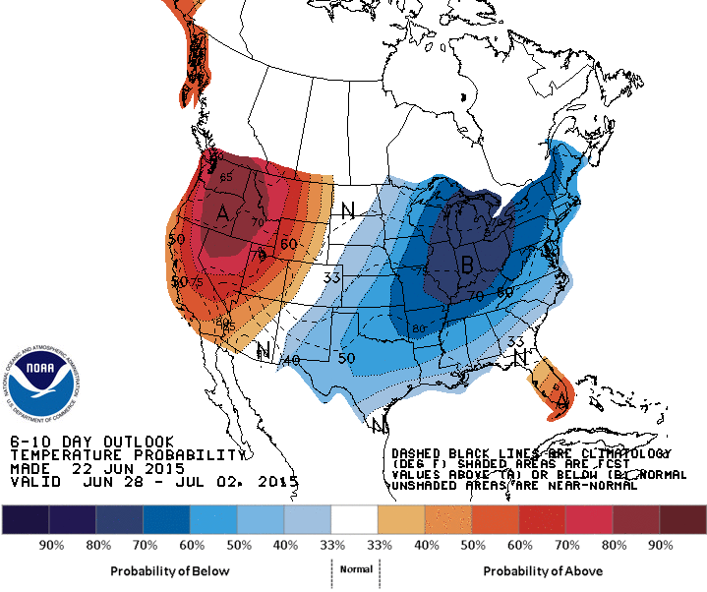
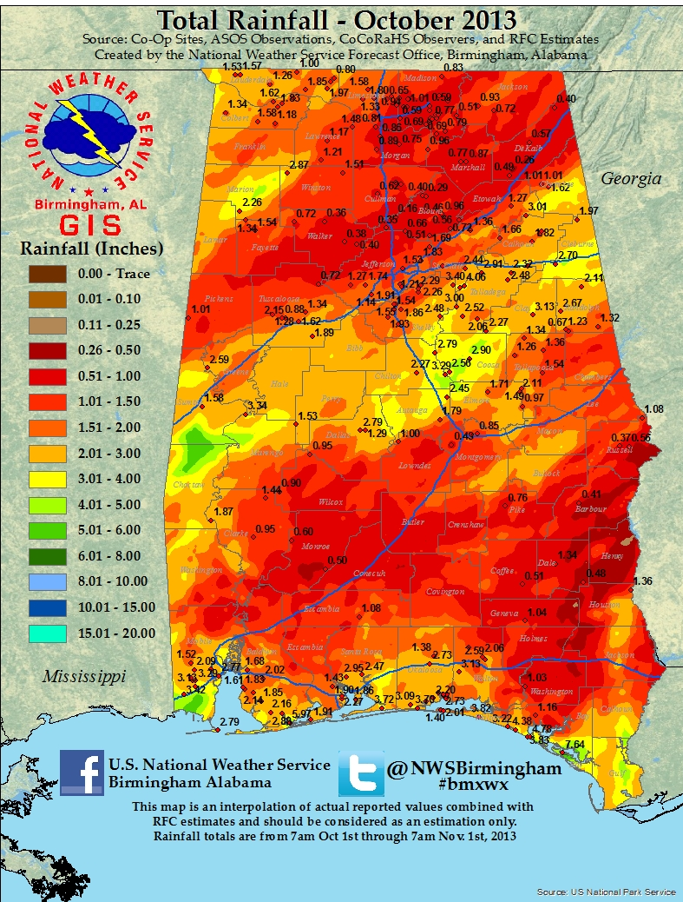
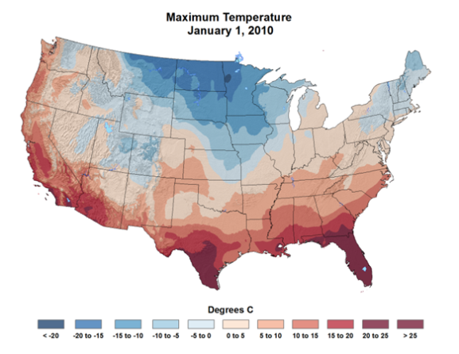
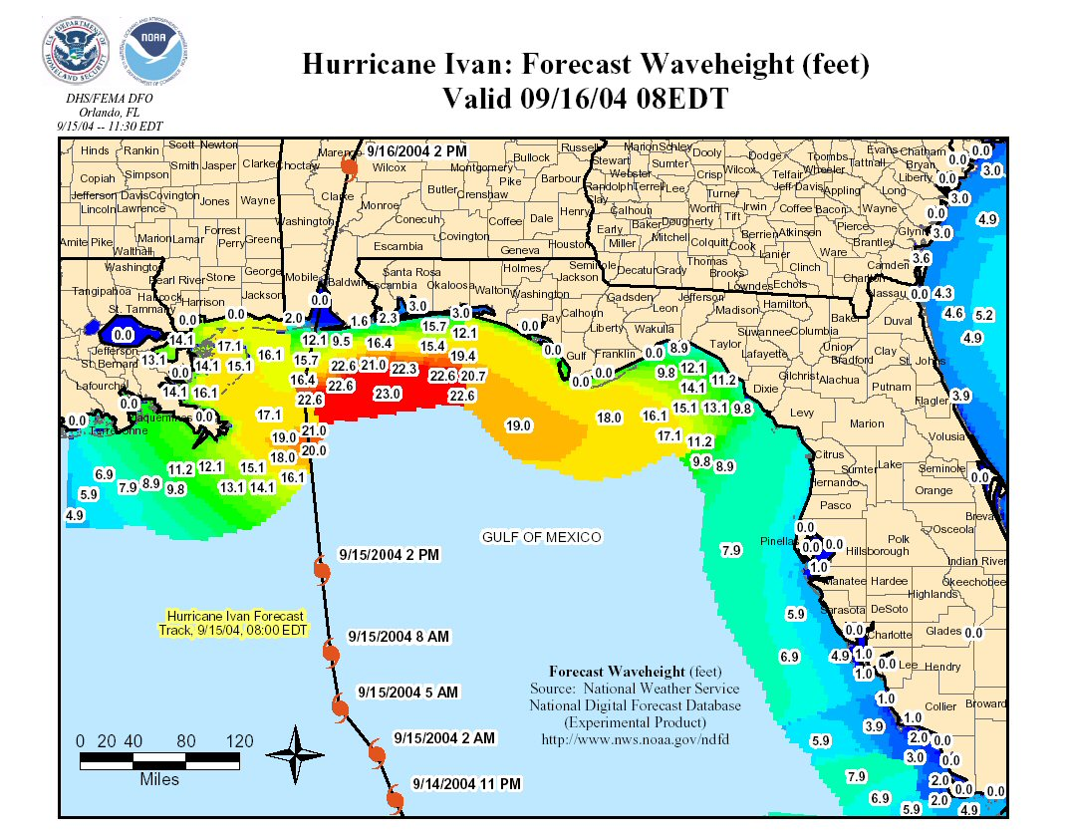
Weather & Climate Data already in GIS
Notes:
Many, many others

Slide 5
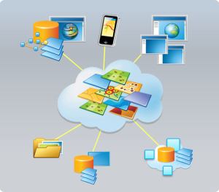
GIS Platforms
Proprietary and Open Source solutions
Desktop / laptop, Tablet, smart phone
“Any location, any time, any device”
Server, cloud
Web – WebGIS
Online GIS Viewers
Web Maps
Web Apps
Notes:
Mention Esri as the industry and NOAA standard, NOAA site license
Difference between these and Google Earth

Slide 6
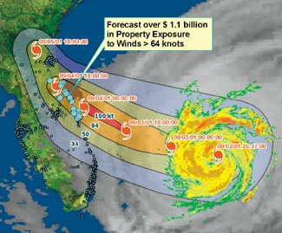
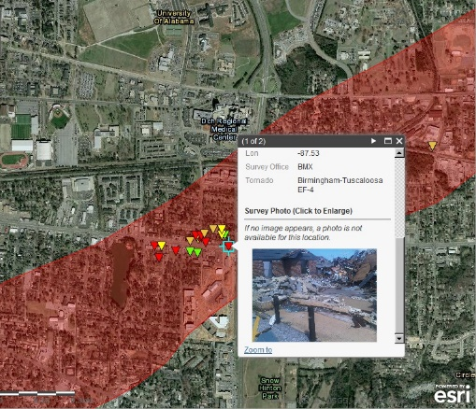
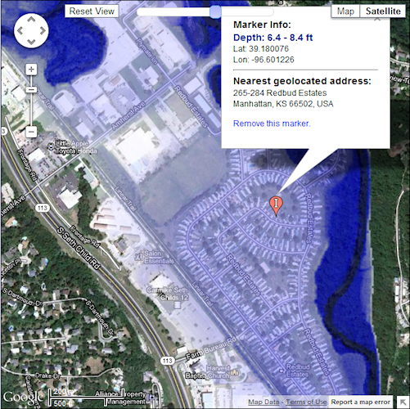
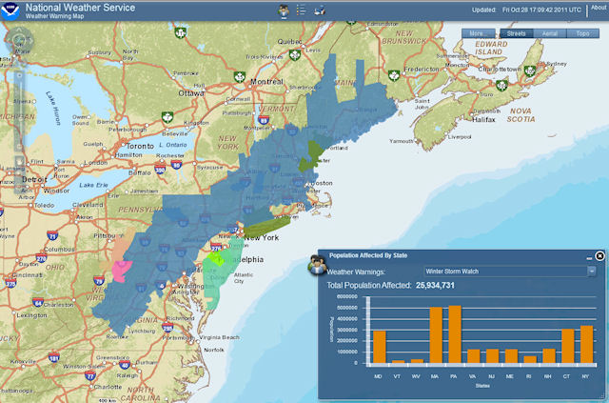
Asking Spatial Questions
How many people will be potentially impacted by:
the current forecasted hurricane track?
a major winter storm?
a severe weather outbreak?
Notes:
Mention many other examples

Slide 7
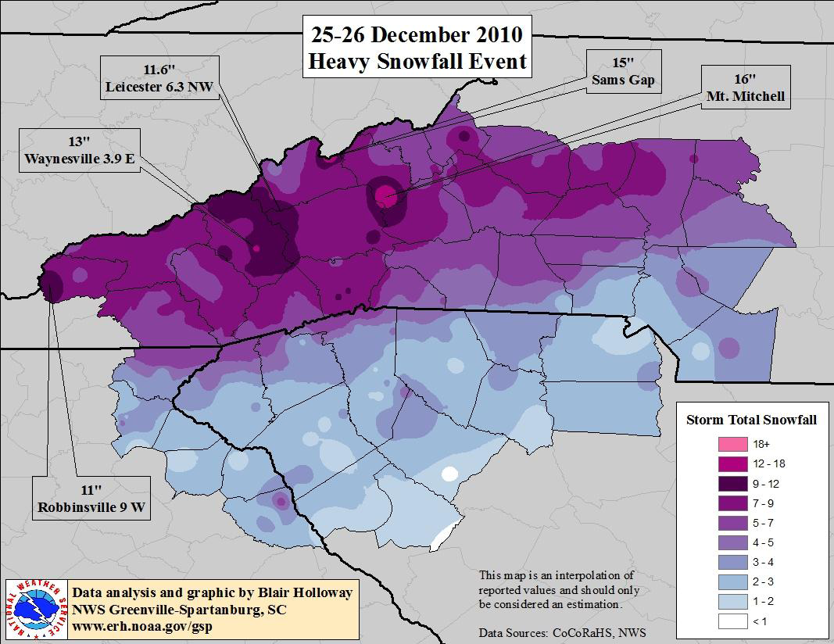
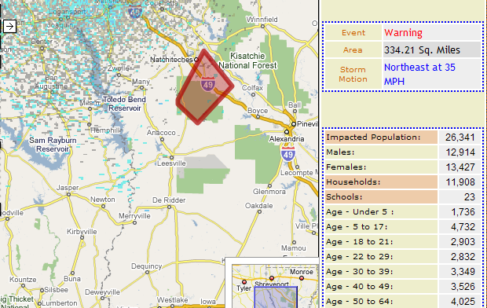
Weather & Climate GIS Applications
Situational awareness
Enhanced mapping and cartography
Daily weather story maps
Pre- and post- event maps
Warning verification
Impact assessments
Public outreach / information
Enhanced flood modeling
Working with time dimensional data
Animating data through time and space
Creating climate assessments
Notes:
NOAA and NWS, and many other agencies have become users of GIS
Have developed standards, etc., license agreements with Esri

Slide 8
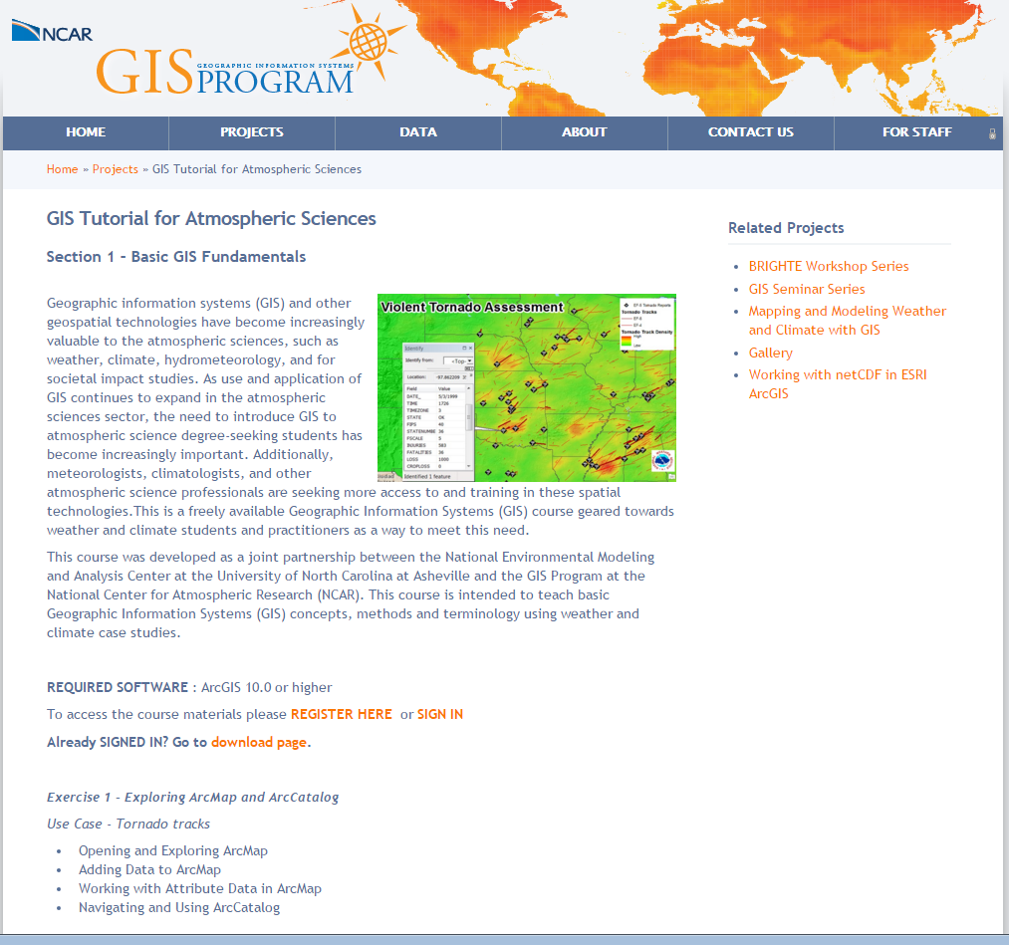
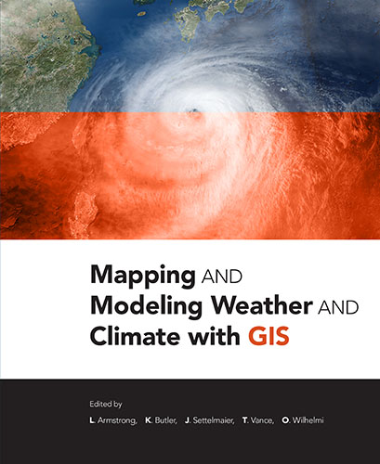
Some Resources
GIS Tutorial for Atmospheric Sciences
https://gis.ucar.edu/projects/course-introduction-gis
Notes:
Talk about the lack of courses that integrate, talk about my class
Talk about certificate programs at community colleges

